Slide 2
How to activate guides
Activating guides
PC instructions
Mac instructions
Right-click anywhere on the slide.
In the drop-down menu that appears, select Grids and Guides.
Check the small white box next to “Display drawing guides on screen.”
Click OK.
Right-click anywhere on the slide.
In the drop-down menu that appears, select Guides.
Check Guides.
Click OK.
PRO TIP: After activating once, your guides will remain on for all documents until they’re deactivated.

Slide 3
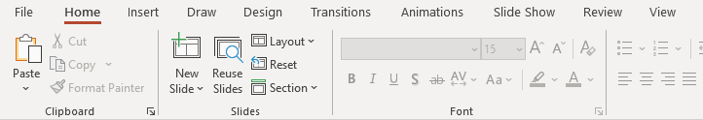
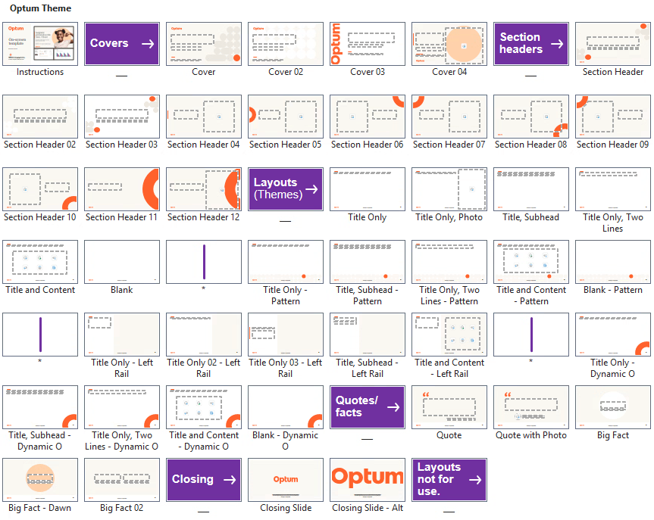
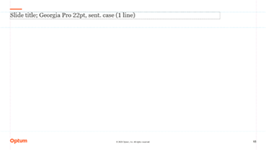
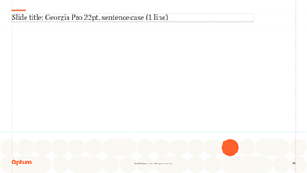
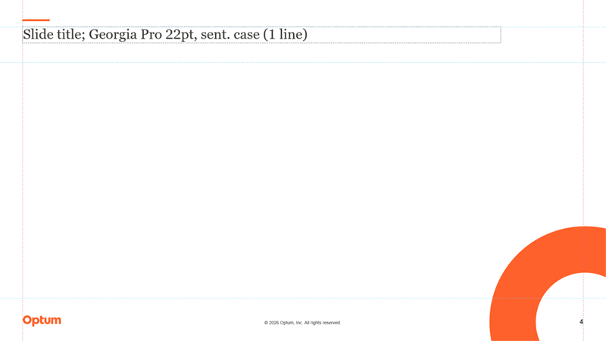
Additional layouts
If another layout is needed that hasn’t been prepopulated in the template, choose one from the “New Slide” drop down. Do not add any new layouts to the template or repurpose any that may accidently creep into the file from copying/pasting.
Introducing new, varying layout themes
There are several themes for use. When developing, it’s strongly recommended that themes not be mixed within a single presentation. Their use should be cohesive throughout.

Slide 4





Make PowerPoint accessible
Slide titles
Images
Content
Color usage
Check accessibility
Give each slide a unique title.
Add a hidden title if graphics take up the slide.
Include alt text with each image.
Keep alt text to 100 characters or less.
Mark images as decorative when appropriate.
Beware of the “wall of content.”
Use numbered or bulleted lists appropriately.
Set a logical reading order.
Use Optum brand-approved colors; limit use of orange.
Don’t use color alone as a signifier.
Review issues flagged by the Microsoft Accessibility Checker.
Fix flagged issues.
Join us at Accessibility Works.
Refer to the Content
Creation Checklist.
Learn more at the
Accessibility Knowledge Center.
Detailed instructions on how to do the above steps are provided
within the Graphic Layout Guide accessibility section.

Slide 5
On-screen font hierarchy
Font style name | Font style formatting specifications
Slide title | Georgia Pro 22pt regular, left-aligned, sentence case
Slide subtitle | Arial 16pt regular, left-aligned, sentence case
Body text (enlarged) | Arial 16pt regular, left-aligned
Graphic title | Arial 15pt bold, left-aligned (typically), sentence case
Graphic subtitle | Arial 14pt italic, left-aligned (typically), sentence case
Chart numbers | Arial 11pt bold, centered (position outside chart)
Chart y- and x-axis labels | X-axis: Arial 11pt regular, centered Y-axis: Arial 11pt regular, right-aligned
Chart y- and x-axis titles | Arial 11pt bold, centered, (Y-axis rotate 90º counter-clockwise)
Legend | Arial 11pt regular, left-aligned to indicator (indicator = shapes, colors, etc.)
Running text, bulleted text, numbered text | Arial 14pt regular, left-aligned
Graphical text, table text, callout text | Arial 13pt regular, left-aligned
Sources, footnotes, image credits | Arial 8pt regular, left-aligned
40pt 30pt large numbers | Varying size of >30pt bold is acceptable (be consistent). Warm Gray is the only approved color. No orange!
Warm Gray is used for all text.
Note: Orange and data visualization colors are never used for text.
Microsoft approved fallback fonts
Arial is primary
Georgia Pro used in limited placeholders

Slide 6
Template defaults
Line
Text box
Table
The default Optum body style text is Arial 14pt regular, text 1 for color. The default Optum body style text is Arial 14pt regular, text 1 for color. The default Optum body style text is Arial 14pt regular, text 1 for color.
The default Optum body style text is Arial 14pt regular, text 1 for color.
Shape attributes

Slide 7
Building blocks
Outline callout
Arrows
Numbers for series
Brackets
White fill and outline is Warm Gray; text is Arial 13pt regular
1
2
3
1
2
3
Quotes
Symbols
1
2
3
Warm Gray callout
Fill and outline is Warm Gray; text is
Arial 13pt regular
Lines

Slide 8


Slide 9


Slide 10


Slide 11


Slide 12


Slide 13


Slide 17


Slide 20


Slide 23


Slide 26


Slide 27


Slide 28


